Slide 1
COURSE NAME – Cloud and devops
COURSE CODE:22CS2243F
Cohort-E27 (SEDP)
Software engineering mis and Devops
prepared by :nirosha bandla
TOPIC:
NETWORKING IN DEVOPS

Slide 2
OSI LAYERS IN NETWORKING
OSI stands for Open Systems Interconnection, where open stands to say non proprietary. It is a 7-layer architecture with each layer having specific functionality to perform. All these 7 layers work collaboratively to transmit the data from one person to another across the globe. The OSI reference model was developed by ISO – ‘International Organization for Standardization‘, in the year 1984.
The OSI model provides a theoretical foundation for understanding network communication. However it is usually not directly implemented in its entirety in real-world networking hardware or software. Instead, specific protocols and technologies are often designed based on the principles outlined in the OSI model to facilitate efficient data transmission and networking operations.

Slide 3
The OSI model, created in 1984 by ISO, is a reference framework that explains the process of transmitting data between computers. It is divided into seven layer
Physical Layer
Data Link Layer
Network Layer
Transport Layer
Session Layer
Presentation Layer
Application Layer

Slide 4
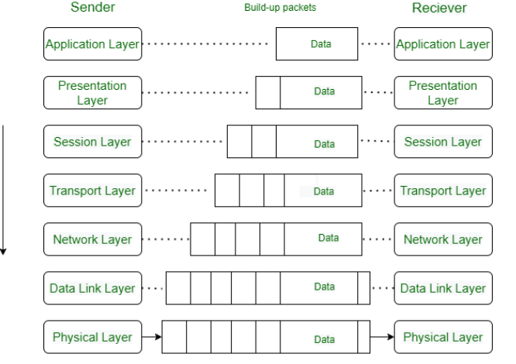
OSI LAYERS

Slide 5
PHYSICAL LAYER
Physical Layer – Layer 1
The lowest layer of the OSI reference model is the physical layer. It is responsible for the actual physical connection between the devices. The physical layer contains information in the form of bits.
It is responsible for transmitting individual bits from one node to the next. When receiving data, this layer will get the signal received and convert it into 0s and 1s and send them to the Data Link layer, which will put the frame back together.

Slide 6
FUNCTIONS OF PHYSICAL LAYER
Bit synchronization: The physical layer provides the synchronization of the bits by providing a clock. This clock controls both sender and receiver thus providing synchronization at the bit level.
Bit rate control: The Physical layer also defines the transmission rate i.e. the number of bits sent per second.
Physical topologies: Physical layer specifies how the different, devices/nodes are arranged in a network i.e. bus, star, or mesh topology.
Transmission mode: Physical layer also defines how the data flows between the two connected devices. The various transmission modes possible are Simplex, half-duplex and full-duplex.

Slide 7
DATA LINK LAYER
The data link layer is responsible for the node-to-node delivery of the message. The main function of this layer is to make sure data transfer is error-free from one node to another, over the physical layer. When a packet arrives in a network, it is the responsibility of the DLL to transmit it to the Host using its MAC address.
The Data Link Layer is divided into two sublayers:
Logical Link Control (LLC)
Media Access Control (MAC)

Slide 8
The packet received from the Network layer is further divided into frames depending on the frame size of the NIC(Network Interface Card).
DLL also encapsulates Sender and Receiver’s MAC address in the header.
The Receiver’s MAC address is obtained by placing an ARP(Address Resolution Protocol) request onto the wire asking “Who has that IP address?” and the destination host will reply with its MAC address.

Slide 9
FUNCTIONS OF DATA LINK LAYER
Framing: Framing is a function of the data link layer. It provides a way for a sender to transmit a set of bits that are meaningful to the receiver. This can be accomplished by attaching special bit patterns to the beginning and end of the frame.
Physical addressing: After creating frames, the Data link layer adds physical addresses (MAC addresses) of the sender and/or receiver in the header of each frame.
Error control: The data link layer provides the mechanism of error control in which it detects and retransmits damaged or lost frames.
Flow Control: The data rate must be constant on both sides else the data may get corrupted thus, flow control coordinates the amount of data that can be sent before receiving acknowledgment.
Access control: When a single communication channel is shared by multiple devices, the MAC sub-layer of the data link layer helps to determine which device has control over the channel at a given time.
Fu

Slide 10
NETWORK LAYER AND ITS FUNCTIONS
The network layer works for the transmission of data from one host to the other located in different networks.
It also takes care of packet routing i.e. selection of the shortest path to transmit the packet, from the number of routes available.
The sender & receiver’s IP addresses are placed in the header by the network
Routing: The network layer protocols determine which route is suitable from source to destination.
This function of the network layer is known as routing.

Slide 11
Logical Addressing: To identify each device inter-network uniquely, the network layer defines an addressing scheme.
The sender & receiver’s IP addresses are placed in the header by the network layer. Such an address distinguishes each device uniquely and universally

Slide 12
TRANSPORT LAYER
The transport layer provides services to the application layer and takes services from the network layer.
The data in the transport layer is referred to as Segments. It is responsible for the end-to-end delivery of the complete message. The transport layer also provides the acknowledgment of the successful data transmission and re-transmits the data if an error is found.
At the sender’s side: The transport layer receives the formatted data from the upper layers, performs Segmentation, and also implements Flow and error control to ensure proper data transmission. It also adds Source and Destination port numbers in its header and forwards the segmented data to the Network Layer.

Slide 13
FUNCTIONS OF TRANSPORT LAYER
Segmentation and Reassembly: This layer accepts the message from the (session) layer, and breaks the message into smaller units.
Each of the segments produced has a header associated with it. The transport layer at the destination station reassembles the message.
Service Point Addressing: To deliver the message to the correct process, the transport layer header includes a type of address called service point address or port address.
Thus by specifying this address, the transport layer makes sure that the message is delivered to the correct process.

Slide 14
SERVICES PROVIDED BY TRANSPORT LAYER
Connection-Oriented Service
Connectionless Service
1. Connection-Oriented Service: It is a three-phase process that includes
Connection Establishment
Data Transfer
Termination/disconnection
In this type of transmission, the receiving device sends an acknowledgment, back to the source after a packet or group of packets is received. This type of transmission is reliable and secure.

Slide 15
2. Connectionless service: It is a one-phase process and includes Data Transfer. In this type of transmission, the receiver does not acknowledge receipt of a packet.
This approach allows for much faster communication between devices.
Connection-oriented service is more reliable than connectionless Service.

Slide 16
SESSION LAYER AND ITS FUNCTIONS
This layer is responsible for the establishment of connection, maintenance of sessions, and authentication, and also ensures secured
Session establishment, maintenance, and termination: The layer allows the two processes to establish, use, and terminate a connection.
Synchronization: This layer allows a process to add checkpoints that are considered synchronization points in the data. These synchronization points help to identify the error so that the data is re-synchronized properly, and ends of the messages are not cut prematurely and data loss is avoided.
Dialog Controller: The session layer allows two systems to start communication with each other in half-duplex or full-duplex.

Slide 17
presentation layer
The presentation layer is also called the Translation layer. The data from the application layer is extracted here and manipulated as per the required format to transmit over the network.
Functions of the Presentation Layer
Translation: For example, ASCII to EBCDIC.
Encryption/ Decryption: Data encryption translates the data into another form or code. The encrypted data is known as the ciphertext and the decrypted data is known as plain text. A key value is used for encrypting as well as decrypting data.
Compression: Reduces the number of bits that need to be transmitted on the network.

Slide 18
application layer
Application Layer – Layer 7
At the very top of the OSI Reference Model stack of layers, we find the Application layer which is implemented by the network applications. These applications produce the data to be transferred over the network. This layer also serves as a window for the application services to access the network and for displaying the received information to the user.
Example: Application – Browsers, Skype Messenger, etc.
: 1. The application Layer is also called Desktop Layer.
2. Device or Protocol Use : SMTP

Slide 19
functions of application layer
The main functions of the application layer are given below.
Network Virtual Terminal(NVT): It allows a user to log on to a remote host.
File transfer access and management(FTAM): This application allows a user to access files in a remote host, retrieve files in a remote host, and manage or
control files from a remote computer.
Mail Services: Provide email service.
Directory Services: This application provides distributed database sourcesand access for global information about various objects and services.

Slide 20
self assesment questions
1.what are diffterent layers in osi model explaion?
2.Explain about transport layer and functions?
3.Explain about application layer and functions?
4.Explain about network layer?
5.how many layers are there in osi model?
6.what are first two layers of osi models and explain?

Slide 21


